Slide 1
Operations and Supply Chain Management BUS102
Md Shamimul Islam, PhD
Notes:
If this PowerPoint presentation contains mathematical equations, you may need to check that your computer has the following installed:
1) MathType Plugin
2) Math Player (free versions available)
3) NVDA Reader (free versions available)

Slide 2
Operations Management (OM)
Definition
OM is the management of systems, which transform inputs into value-added products and/or services.
Primary Functions
Organization
Finance
Operations
Marketing
Support Functions – R&D, HR, PR, Accounting, etc.
Notes:
R&D=research and development, HR= human resource, PR=public relation

Slide 3
Value-Added
The difference between the cost of inputs and the value or price of outputs.
Value added
Inputs
Transformation/
Outputs
Land
Conversion
Goods
Labor
process
Services
Capital
Feedback
Control
Feedback
Feedback

Slide 4
Food Processor
Inputs
Processing
Outputs
Raw Vegetables
Cleaning
Canned vegetables
Metal Sheets
Making cans
Water
Cutting
Energy
Cooking
Labor
Packing
Building
Labeling
Equipment

Slide 5
Hospital Process
Inputs
Processing
Outputs
Doctors, nurses
Examination
Healthy patients
Hospital
Surgery
Medical Supplies
Monitoring
Equipment
Medication
Laboratories
Therapy

Slide 6
Manufacturing or Service?
Tangible
Act
Notes:
Manufacturing products are mostly tangible. On the other hand services are mostly related to actions.

Slide 7
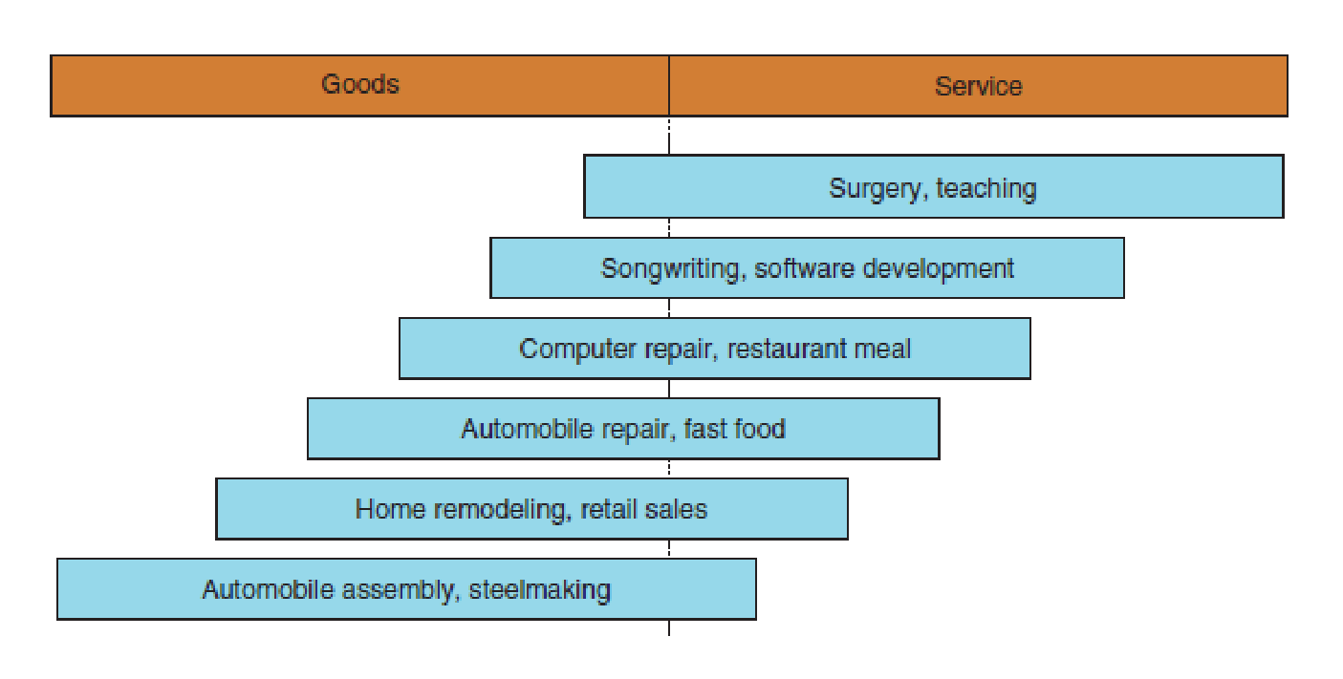
The goods–service continuum
Notes:
These are some real life examples of manufacturing and service firms

Slide 8
Production of Goods vs. Delivery of Services
Production of goods – tangible output
Delivery of services – an act (Intangible)
Service job categories
Government
Wholesale/retail
Financial services
Healthcare
Personal services
Business services
Education

Slide 9
Manufacturing vs Service
Characteristic
Manufacturing
Service
Output
Tangible
Intangible
Customer contact
Low
High
Uniformity of input
High
Low
Labor content
Low
High
Uniformity of output
High
Low
Measurement of productivity
Easy
Difficult
Opportunity to correct
High
Low
quality problems

Slide 10
Scope of Operations Management
Operations Management includes:
Forecasting
Capacity planning
Scheduling
Managing inventories
Assuring quality
Motivating employees
Deciding where to locate facilities
Supply Chain Management (SCM)
And more . . .

Slide 11
Operations Function
The operations function
Consists of all activities directly related to producing goods or providing services

Slide 12
Types of Operations
Operations
Examples
Goods Producing
Farming, mining, construction
,
manufacturing, power generation
Storage/Transportation
Warehousing, trucking, mail
service, moving, taxis, buses,
hotels, airlines
Exchange
Retailing, wholesaling,
banking, renting, library, loans
Entertainment
Films, radio and television,
concerts, recording
Communication
Newspapers, radio and television
newscasts, email, telephone,
satellites

Slide 13
Supply Chain Management

Slide 14
What Is a Supply Chain? (2 of 3)
Customer is an integral part of the supply chain
Includes movement of products from suppliers to manufacturers to distributors and information, funds, and products in both directions
May be more accurate to use the term “supply network” or “supply web”
Typical supply chain stages: customers, retailers, wholesalers, distributors, manufacturers, suppliers

Slide 15
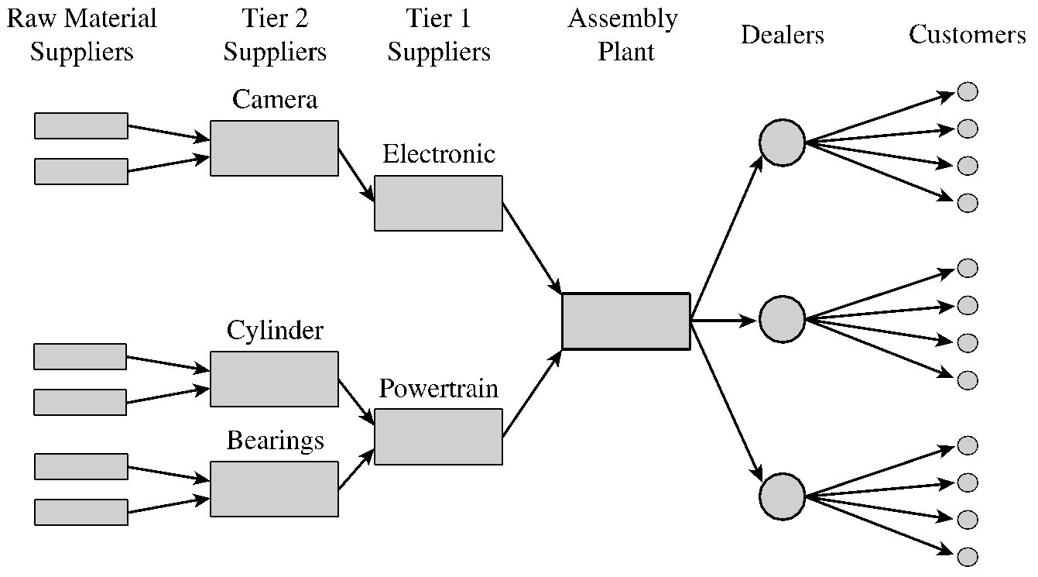
What Is a Supply Chain? (3 of 3)
Figure 1-1 Stages of an Automotive Supply Chain
Notes:
Notes:
Supply chain involves everybody, from the customer all the way to the last supplier.
Key flows in the supply chain are - information, product, and cash. It is through these flows that a supply chain fills a customer order. The management of these flows is key to the success or failure of a firm. Give Dell & Compaq example, Amazon & Borders example to bring out the fact that all supply chain interaction is through these flows.

Slide 16
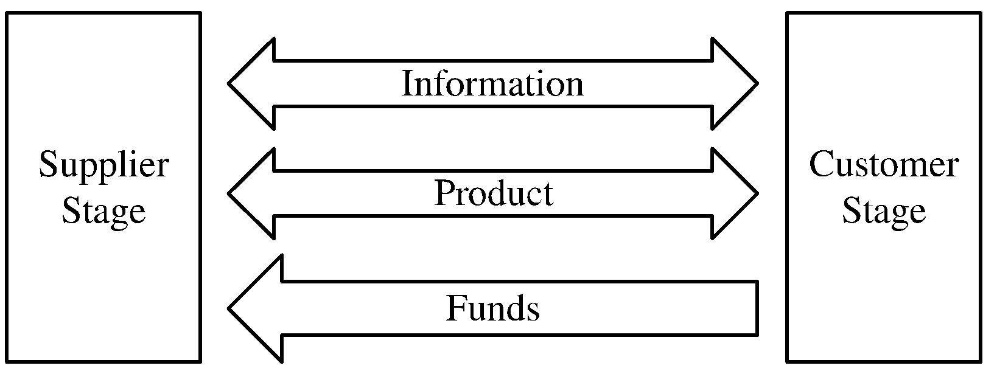
Flows in a Supply Chain
Figure 1-2 The Three Flows in a Supply Chain

Slide 17
The Objective of a Supply Chain (1 of 3)
Maximize net value generated
Supply Chain Surplus = Customer Value − Supply Chain Cost

Slide 18
The Objective of a Supply Chain (2 of 3)
Example: a customer purchases a wireless router from Best Buy for $60 (revenue)
Supply chain incurs costs (convey information, produce components, storage, transportation, transfer funds, etc.)
Difference between $60 and the sum of all of these costs is the supply chain profitability
Supply chain profitability is total profit to be shared across all stages of the supply chain
Success should be measured by total supply chain surplus, not profits at an individual stage

Slide 19
The Objective of a Supply Chain (3 of 3)
Customer the only source of revenue
Sources of cost include flows of information, products, or funds between stages of the supply chain
Effective supply chain management involves the management of supply chain assets and product, information, and fund flows to grow the total supply chain surplus

Slide 20
Decision Phases in a Supply Chain
Supply chain strategy or design
How to structure the supply chain over the next several years
Supply chain planning
Decisions over the next quarter or year
Supply chain operation
Daily or weekly operational decisions

Slide 21
Drivers of Supply Chain Performance
Facilities • places where inventory is stored, assembled, or fabricated • production sites and storage sites
Inventory • raw materials, WIP(work in progress), finished goods within a supply chain • inventory policies
Transportation • moving inventory from point to point in a supply chain • combinations of transportation modes and routes

Slide 22
Drivers of Supply Chain Performance, Contd.
Information • data and analysis regarding inventory, transportation, facilities throughout the supply chain • potentially the biggest driver of supply chain performance
Sourcing • functions a firm performs and functions that are outsourced
Pricing • Price associated with goods and services provided by a firm to the supply chain

Slide 23
Sustainable and Green Supply Chain
Sustainable supply chain management (SSCM)is defined it as “the management of material, information and capital flows as well as cooperation among companies along the SC while taking goals from all three dimensions of sustainable development, i.e., economic, environmental and social, into account which are derived from customer and stakeholder requirements”.
Green supply chain management (GSCM) can be defined as the integration of environmental management system into the supply chain process including collaboration with customers, suppliers, and logistics service providers to share information and knowledge with an aim to improve environmental performance.

